Slide 1


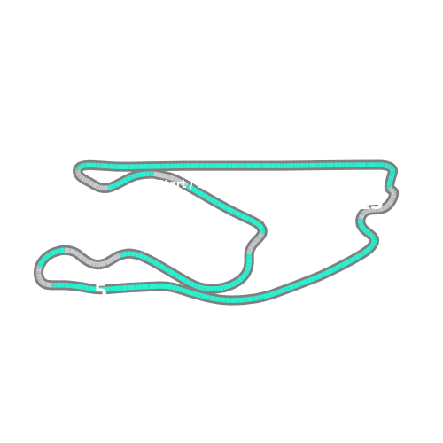


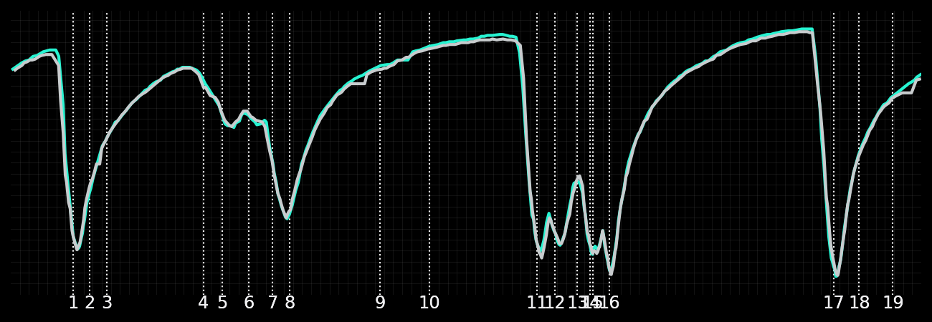
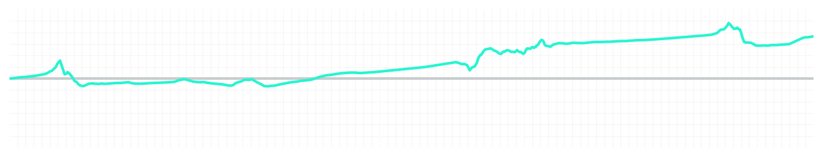
Miami GP Sprint Quali Q3
Kimi Antonelli
Driver
George Russell
Driver
Lap Time
01:26.482
01:26.791
Lap Time
Sector 1
28.668
Speed Trap 1
224 kp/h
Speed Trap 1
220 kp/h
Sector 1
28.678
Sector 2
32.978
Speed Trap 2
193 kp/h
Gap
-0.309
Gap
0.309
Speed Trap 2
193 kp/h
Sector 2
33.266
Sector 3
24.836
Speed Final Line
286 kp/h
Corner Advantage
8/20
Corner Advantage
12/20
Speed Final Line
283 kp/h
Sector 3
24.847
FULL THROTTLE
59%
59%
FULL THROTTLE
HEAVY BREAKING
14%
16%
HEAVY BREAKING
%LAP TIME
CORNERING
27%
25%
CORNERING
%LAP TIME
SPEED
SPEED
DELTA TIME
DELTA TIME

Slide 2

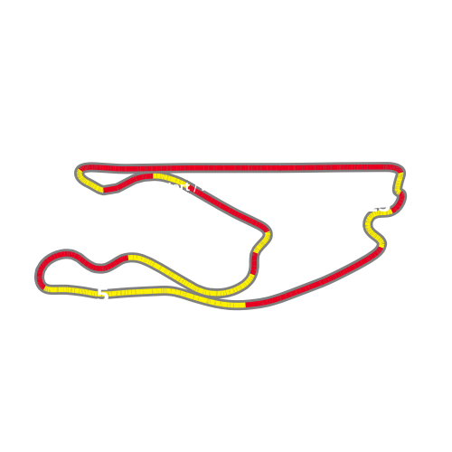


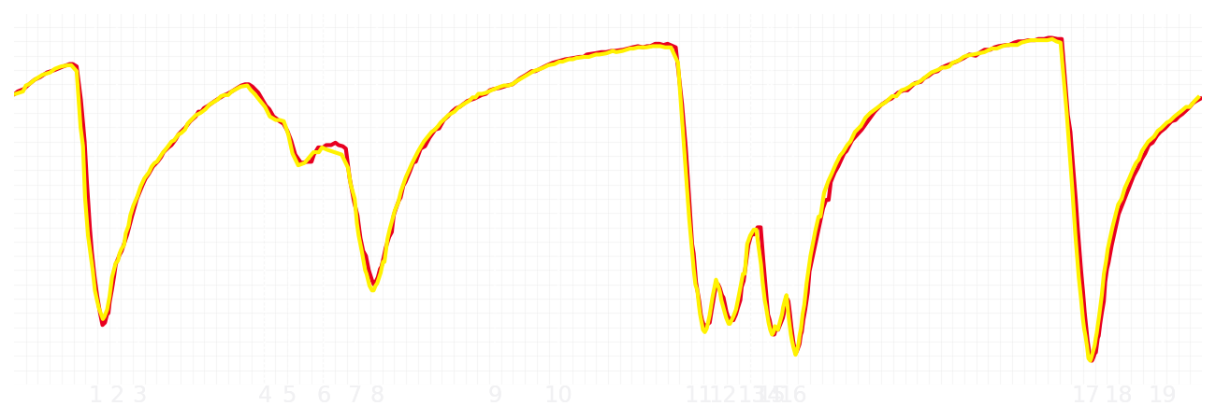
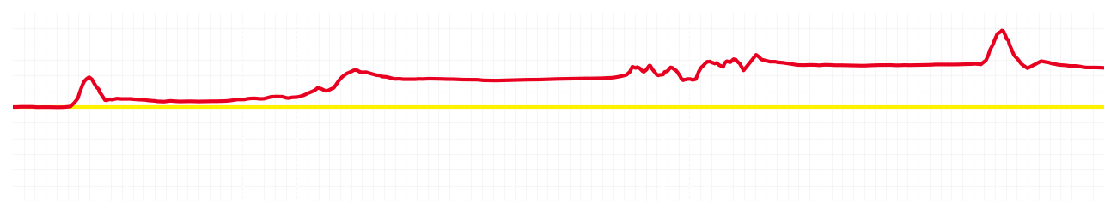
Miami GP Sprint Quali Q3
Charles Leclerc
Driver
Lewis Hamilton
Driver
Lap Time
01:26.808
01:27.030
Lap Time
Sector 1
28.756
Speed Trap 1
224 kp/h
Speed Trap 1
223 kp/h
Sector 1
28.912
Sector 2
33.107
Speed Trap 2
192 kp/h
Gap
-0.222
Gap
0.222
Speed Trap 2
194 kp/h
Sector 2
33.178
Sector 3
24.945
Speed Final Line
285 kp/h
Corner Advantage
9/20
Corner Advantage
11/20
Speed Final Line
285 kp/h
Sector 3
24.940
FULL THROTTLE
58%
62%
FULL THROTTLE
HEAVY BREAKING
18%
20%
HEAVY BREAKING
%LAP TIME
CORNERING
24%
18%
CORNERING
%LAP TIME
SPEED
SPEED
DELTA TIME
DELTA TIME

Slide 3

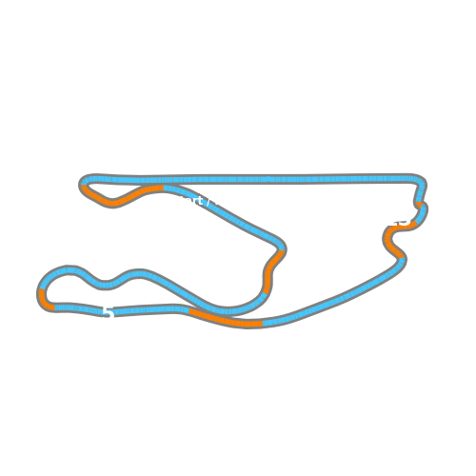


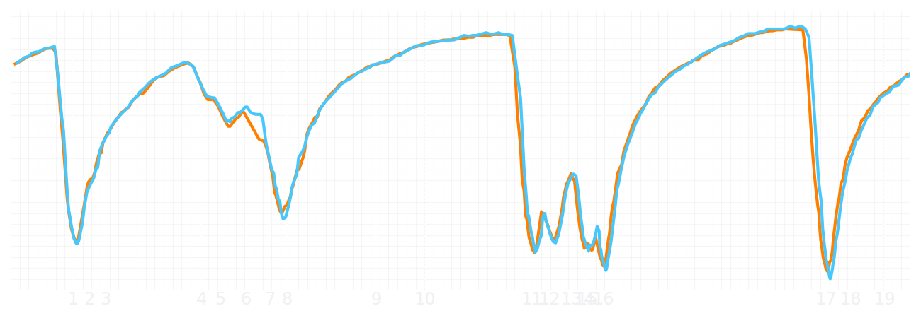
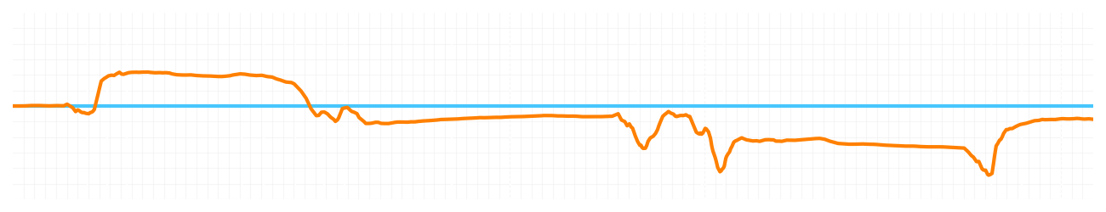
Miami GP Sprint Quali Q3
Lando Norris
Driver
Oscar Piastri
Driver
Lap Time
01:26.582
01:26.527
Lap Time
Sector 1
28.740
Speed Trap 1
222 kp/h
Speed Trap 1
221 kp/h
Sector 1
28.648
Sector 2
32.990
Speed Trap 2
191 kp/h
Gap
0.055
Gap
-0.055
Speed Trap 2
193 kp/h
Sector 2
32.936
Sector 3
24.852
Speed Final Line
285 kp/h
Corner Advantage
11/20
Corner Advantage
9/20
Speed Final Line
286 kp/h
Sector 3
24.943
FULL THROTTLE
59%
59%
FULL THROTTLE
HEAVY BREAKING
15%
17%
HEAVY BREAKING
%LAP TIME
CORNERING
26%
24%
CORNERING
%LAP TIME
SPEED
SPEED
DELTA TIME
DELTA TIME

